Slide 1
DNS SubDomain Scanner A Multihreaded Web Based DNS Subdomain Bruteforcer
Group Members:
Sadaqat Ali
Muhammad Abdullah
Naveed Gondal

Slide 2
DNS Sub-Domain Scanner Intro
DNS SubDomain Scanner is web based tool which scan subdomain for a given domain name and resolve these domain names to get DNS queries.
It is multithreaded programm written in C and integrated with React and NodeJS to make an interactive UI

Slide 3
Problems
Here arise, some problems:
The main problems we face when do pen testing and gather data about target is that this is very slow process. It takes much time to gather data about a target domain
Bruteforcing is also a very much time consuming when used in Pen Testing
There is no interactive application available for Pen Testers to gather data about a target.
Solutions:
To solve the problem of time consuming data gathering we made it much faster using multithreading
As bruteforcing take much time but when done in multipe threads on multiple cores it can be done very fast
React is an interactive library with NodeJS its back make much more interactve UI then anyother technology can make

Slide 4
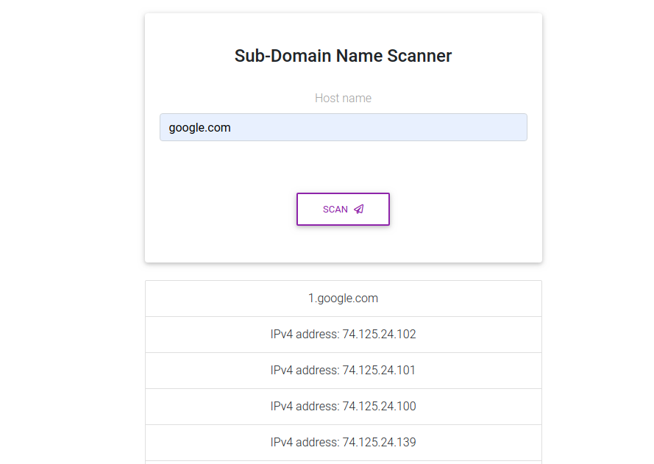
Output

Slide 5
Limitations
It can scan subdomains of a single domain at one time of execution.
NodeJS is not fully compatible with C and other low level languages so it is very difficult task to integrate C with Node and React
It show some lags on front-end and frontend is not yet fully interactive but it do fulfill all the basic functionality

Slide 6
Future Scope
Its Scope can be extended to all types of scanning including port scanning etc
This can be implemented to use multiple multithreaded Programms written in C to get maximum benefit of both C and NodeJS

Slide 7
Conclusion
This project helped me to understand how multithreading works and how to integrate multitheading in C with the latest web technologies to make more interactive and innovative Tools

Slide 8
THANK YOU

